Slide 1

Finance and Risk Analytics
Submitted by: Jacob Simon Areickal
Submitted on: 15-MAY-2023

Slide 2
Task 1 - Data loading

Slide 3
Loading data to pandas
We used Pandas library in Python to load the data in each domain to a Pandas dataframe
There were a total of 4 domains in the data provided:
Aviation
Finance
Pharma Healthcare
Technology
Each domain has 6 datasets and there was also a market standard dataset as well (S&P500)
After storing our datasets in Pandas dataframes, we asserted that all the dataframes are non empty
We also checked the number of rows and columns in each of the dataframes

Slide 4
Task 2 - Data cleaning

Slide 5
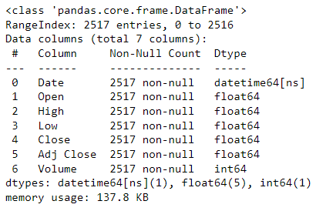
Part 1 - Cleaning the data
Data cleaning was divided into 2 parts:
Validation of datatype of the columns
Handling of null values
We validated datatypes of all the columns in our dataframes. We inferred that the “Date” column in all our dataframes had an incorrect datatype. We then cast the Date column to ‘datetime64[ns]’ format
Below is the datatypes of all columns after validation and casting to the appropriate types:

Slide 6
Part 2 - Cleaning the data
We then calculated the number of null values in each of the dataframes
We found that there were 0 null values in three of the dataframes (AAL, AAPL, SP500) and an approximate 49-56 null values in the rest of our dataframes.
Since the number of null values is very small and negligible compared to thousands of rows in the dataframes, we proceeded to delete rows if any NA/null values are present in any of the columns
After dropping the null/NA rows, a final validation was made to make sure that there were 0 null values in all the dataframes.
We also checked the number of rows in all the dataframes after handling the null values. All dataframes had 2000+ rows which is sufficient for our analysis

Slide 7
Task 3 - Data MERGING

Slide 8
Merging the data
Only three required columns (‘Date’, ‘Close’ , ‘Volume’) were kept in the final dataframe. Rest of the columns were discarded
The stock/company name was prefixed to the columns Close and Volume of each dataframe
All the dataframes are then merged together using inner join on the Date column to get our final merged dataframe
As part of the active investment strategy, we will try to replicate the daily gains/returns from the past five years over the future to predict the value of the selected stocks. So only the data from the last 5 years that is from 01/10/2015 to 30/09/2020 were kept in the merged dataframe and rest of the rows were discarded
The filtered merged dataframe had a total of 1259 rows and 51 columns

Slide 9
Task 4 – exploratory data analysis

Slide 10
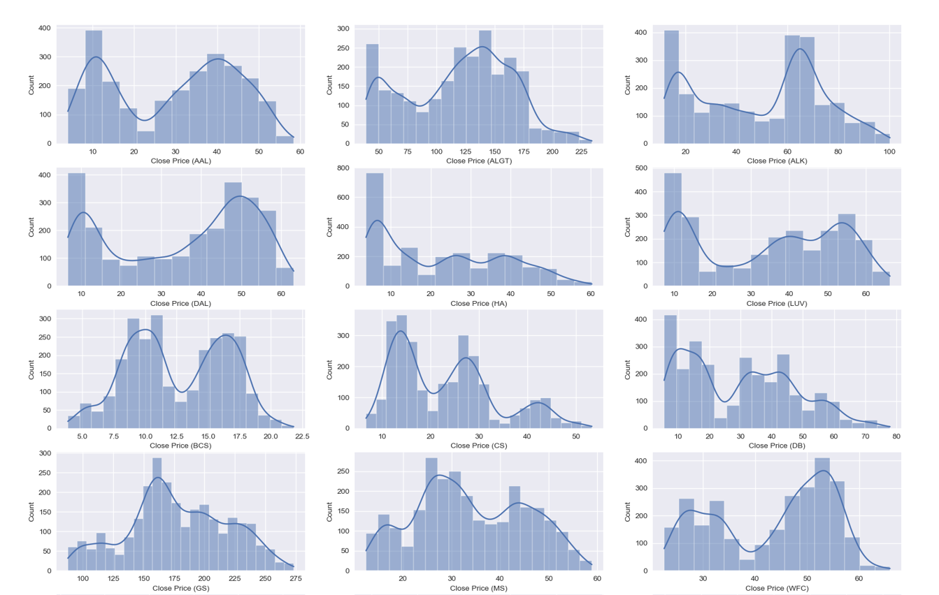
Part 1 - Exploring the data (DIST PLOT)

Slide 11
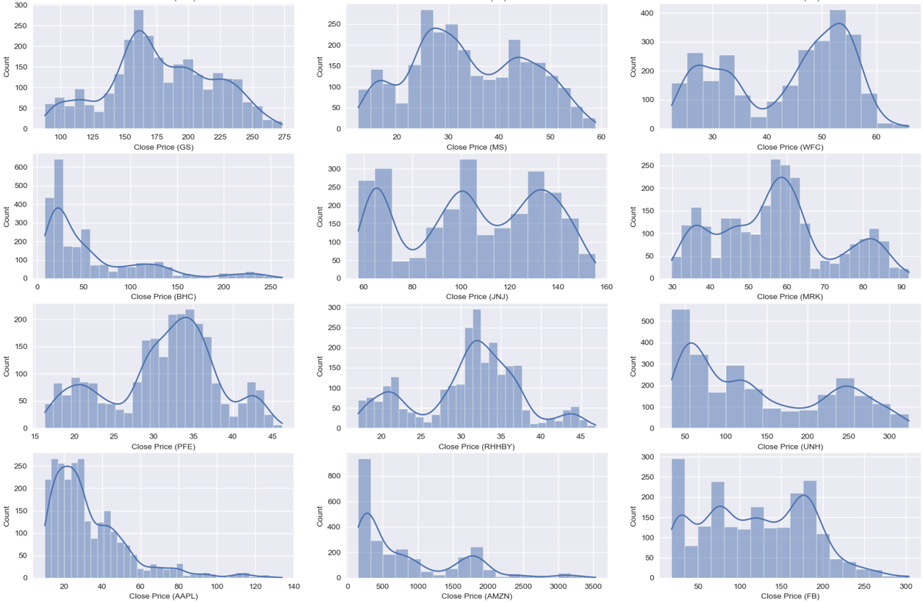
Part 1 - Exploring the data (DIST PLOT) Continued..

Slide 12
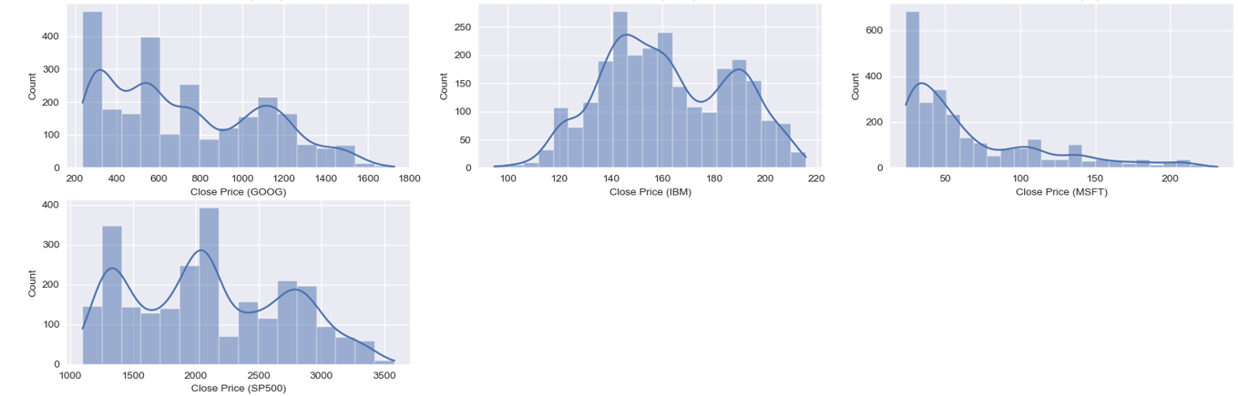
Part 1 - Exploring the data (DIST PLOT) Continued..

Slide 13
Part 1 - Exploring the data (DIST PLOT) Continued..
The 3 figures in the previous slides are the distribution plots for ‘Close’ prices of all the stcoks in the dataframe
The horizontal coordinate is the stock closing price bins and the vertical coordinate is the count of the closing price bin data
Below are the observations that can be made:
The above distribution plots helped us to understand the bin/ ranges where the majority of the data lies
Majority of the Close prices for IBM lies in the range of 140-160 and a very less percentage of the Close prices are in the range of 100 and below
Another interesting observation can be made for AMZN stock where majority of the close prices lie in the 0-500 range. Very less percentage of the close prices for AMZN cross the 1000+ range. This gives us a clue that the stock seems to be pretty risky and volatile and tend to not follow market standards

Slide 14
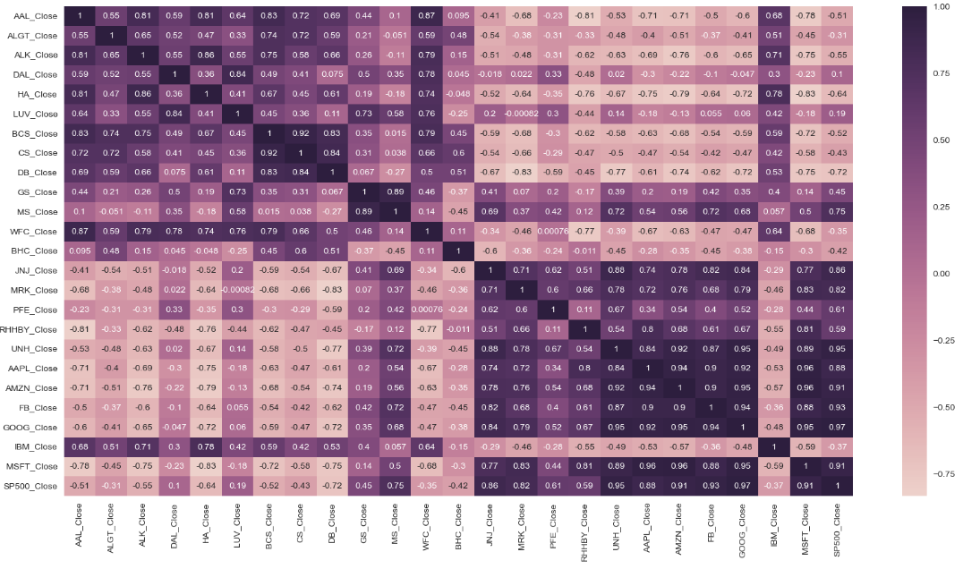
Part 2 - Exploring the data (CORR PLOT)

Slide 15
Part 2 - Exploring the data (CORR PLOT) Continued..
Correlation between two assets is measured using a mathematical formula that produces what is called the Pearson correlation coefficient, represented by R. This correlation coefficient can range from -1.0 to 1.0
A positive number represents a positive correlation, meaning the assets tend to move in the same direction. A negative number represents a negative correlation, meaning the assets are inversely correlated or tend to move in opposite directions
For the purpose of this study, here is how I define correlation using the correlation coefficient:
Strong positive correlation: 0.75 to 1.0
Moderate positive correlation: 0.50 to 0.75
Low positive correlation: 0.25 to 0.50
No correlation: -0.25 to 0.25
Low negative correlation: -0.25 to -0.50
Moderate negative correlation: -0.50 to -0.75
Strong negative correlation: -0.75 to -1.0

Slide 16
Part 2 - Exploring the data (CORR PLOT) Continued..
Below are my observations from the correlation/heatmap plot:
Most investment assets are correlated with the stock market index S&P500.
Strongly correlated assets—those with a correlation coefficient of 0.75 or greater tend to follow stock market patterns. While that doesn't necessarily mean they aren't great diversification tools for other reasons, it does mean that they might not offer as much recession protection as other asset classes.
Stocks like BCS, CS, DB, BHS and IBM all have a negative correlation with the stock market index S&P500 which means that those stocks are riskier and tend to not follow the stock market patterns
Stocks like MS, JNJ, MRK, UNH, AAPL, AMZN, FB, GOOG and MSFT all have a very good positive correlation with the market index which generally means that they tend to follow market patterns when compared with the rest

Slide 17

Part 3 – NORMALISING THE DATA
The prices of all the stocks are in different scales. Hence it is important to normalize the data and bring the prices to the same scale
Here I used Maximum Absolute Scaler (MAX ABS) to bring all the prices in the range of -1 to 1
The formula used for normalization is as below:

Slide 18
Part 3 – NORMALISING THE DATA (Continued..)
Using the normalized data, we plotted a line plot to show the relative changes in stock price with respect to market index
We used the date on the x axis and the close price of the stock divided by the close price of S&P500 on the y axis
The plot was used to check for any trends in the data with respect to the market index
The plot can be found in the next slide for reference

Slide 19
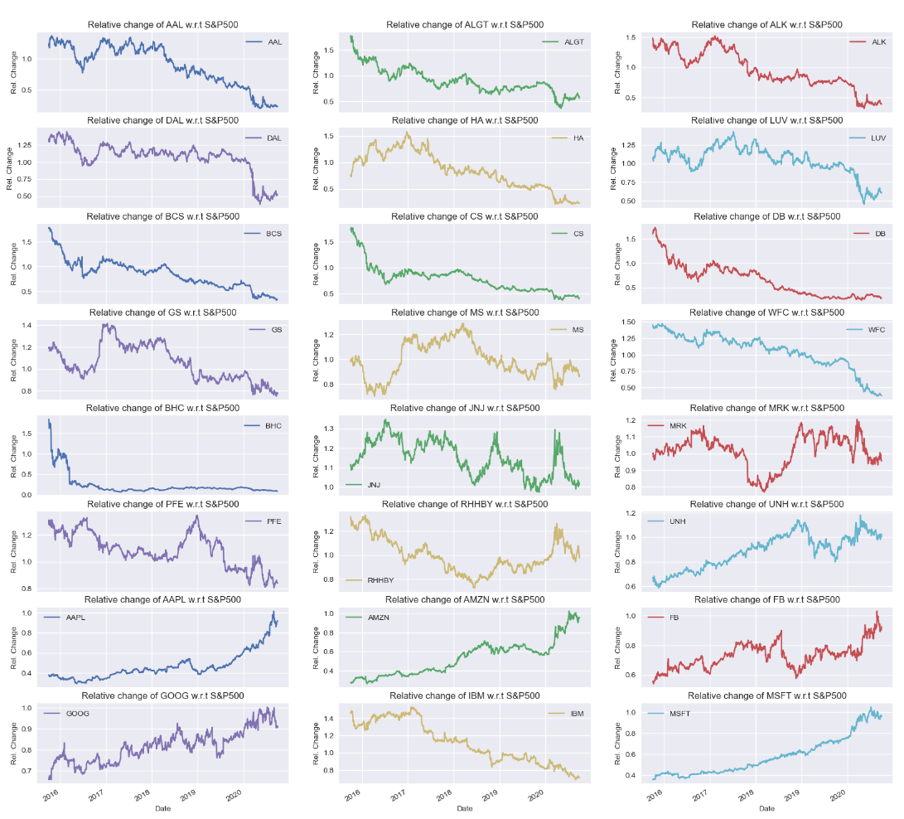
Part 3 – NORMALISING THE DATA (Continued..)

Slide 20
Task 5 – stock statistics

Slide 21
Part 1 – calculating stock metrics
The below metrics was calculated to understand the stocks better and to learn how they perform in comparison to the market standard:
Daily return from each stock
Average return from each stock
Total return from the portfolio during the given period
Cumulative return from the portfolio in the given period
Risk associated with the portfolio
Annualized Returns From each stock
Annualized Risk From each stock
Annualized Cumulative Returns from each stock
Sharpe ratio
CAPM

Slide 22

1 - Daily return from each stock
This refers to the daily gains earned by the investor. This measure helps the investor/analyst monitor the change in the stock on a daily basis. A positive return suggests the stock has grown in value, while a negative return means it has lost value
Moreover, this can also be used to assess the risk in the stock. If the absolute value of daily returns is high, it means that the security is very volatile, and hence, carries a larger risk
The daily returns was calculated for each stock using the below formula:

Slide 23
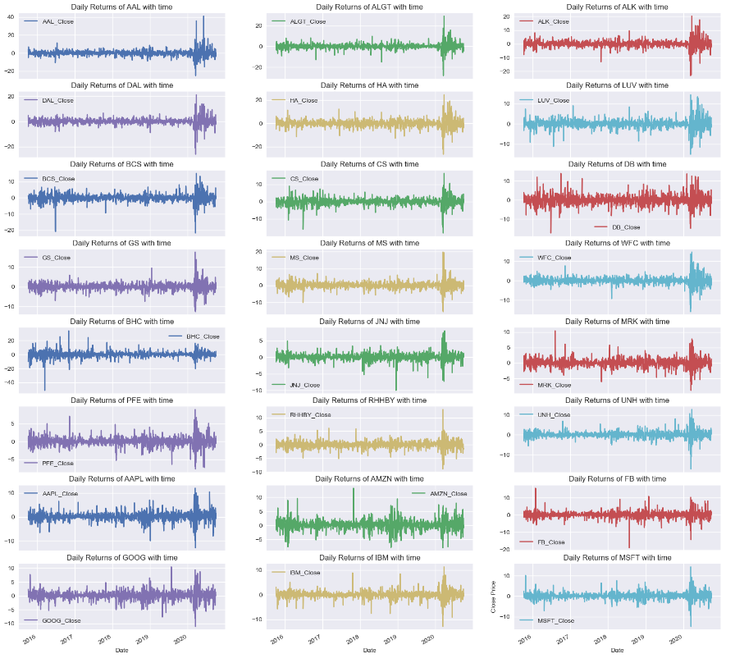
Daily return with time plot

Slide 24
2 - Average daily return from each stock
Average daily return for each stock can be calculated using the dataframe created above - "stocks_daily_returns"
We used the inbuilt mean() to calculate the mean of daily returns for each stock
The average return is the simple mathematical average of a series of returns generated over a specified period of time.
An average return is calculated the same way that a simple average is calculated for any set of numbers. The numbers are added together into a single sum, then the sum is divided by the count of the numbers in the set.

Slide 25
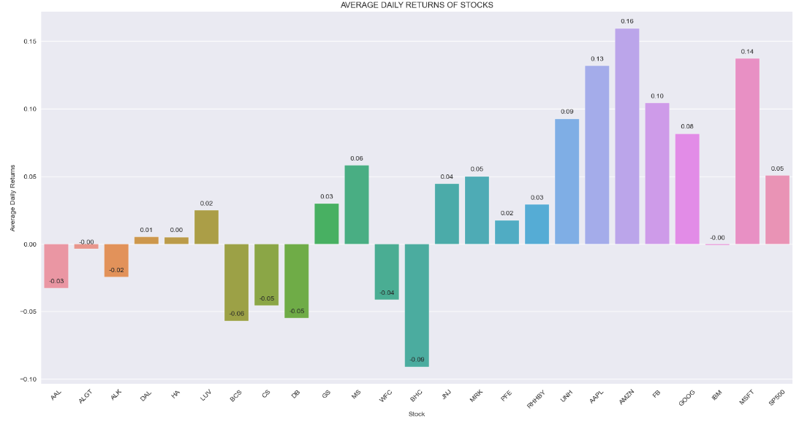
Average daily return BAR Plot

Slide 26
Average daily return BAR Plot continued..
Below observations can be made from the bar plot of average daily returns:
AMZN has the highest average daily returns at 0.16. We need to keep in mid that this does not account for the risk factor and does not necessarily tell us if the stock if good enough for a specific portfolio or not
BHC has the lowest returns which sits at -0.09 which suggests the stock did not do too good in the market
It is always better to annualize these metrics and filter only those stocks with has positive returns. This will be done in the upcoming parts
There are some stocks that have negative returns. It is better to eliminate these stocks from the portfolio

Slide 27
4 - Cumulative Return From Each Stock
The cumulative return provides information on the aggregate gains earned by the investor over a period of time
It can be simply calculated using the current price and the purchase price of the stock.
However, to get a more accurate figure, we can also add the dividends paid by the company to the numerator

Slide 28
5 - Risk associated from each stock (Standard Deviation)
Risk management is a crucial process used to make investment decisions. Risk management involves identifying and analyzing risk in an investment and deciding whether or not to accept that risk given the expected returns for the investment.
Some common measurements of risk include standard deviation, Sharpe ratio, beta, value at risk (VaR), conditional value at risk (CVaR), and R-squared.
We will be making use of three metrics predominantly to access risk of a stock:
Standard Deviation
Beta coefficient using CAPM
Sharpe Ratio

Slide 29
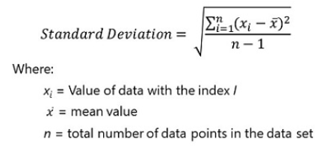
5 - Risk associated from each stock (Standard Deviation) continued..
Standard Deviation metric provides the measure of risk in the portfolio. If the value of the standard deviation is high, the underlying security is very volatile and has more exposure to risk

Slide 30
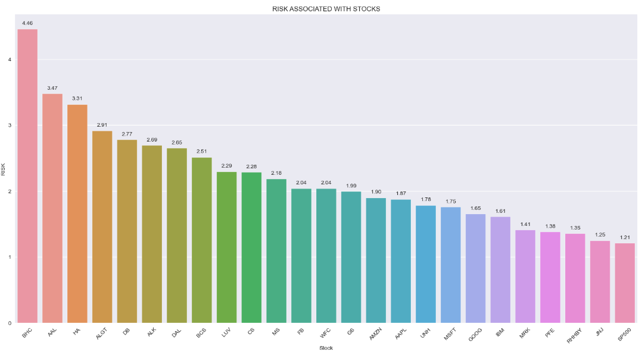
5 - Risk associated from each stock (Standard Deviation) continued..

Slide 31
5 - Risk associated from each stock (Standard Deviation) continued..
Below observations can be made from the risk bar plot:
BHC is the riskiest stock with a risk value of 4.46
JNJ and S&P500 are two of the least riskiest stocks with a risk value of 1.25 and 1.21 respectively
High risk stocks tend to be volatile and not follow the market index patterns where as on the contrary low risk stocks tend to be less riskier and follow market patterns

Slide 32
6 - Annualised Returns From each stock
Also known as an annualized return, the annual return expresses the stock’s increase in value over a designated period of time.
In order to calculate an annual return, information regarding the current price of the stock and the price at which it was purchased are required.
If any splits have occurred, the purchase price needs to be adjusted accordingly. Once the prices are determined, the simple return percentage is calculated first, with that figure ultimately being annualized.
The simple return is just the current price minus the purchase price, divided by the purchase price.

Slide 33
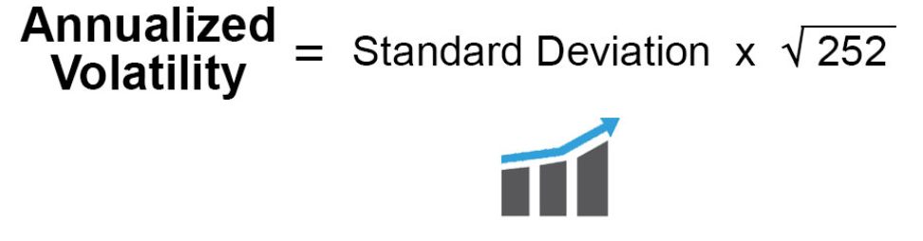
7 - Annualised Risk From each stock
Annualized volatility / Annualised risk is a statistical measure of the dispersion of returns of a financial instrument over a given period, expressed in terms of an annualized standard deviation. It is used to quantify the risk of an investment or a portfolio by indicating how much the value of an investment is likely to fluctuate over a given period
The higher the annualized volatility, the greater the risk of the investment. Annualized volatility is typically calculated using historical return data and is expressed as a percentage. Investors often use it to help them make informed decisions about their investments.
The purpose of annualized volatility is to extrapolate data over the course of a year. It allows investors to compare the risk of investments with different return periods, such as daily, weekly, or monthly, and to compare the risk of investments with different time horizons, such as one year, five years, or ten years

Slide 34
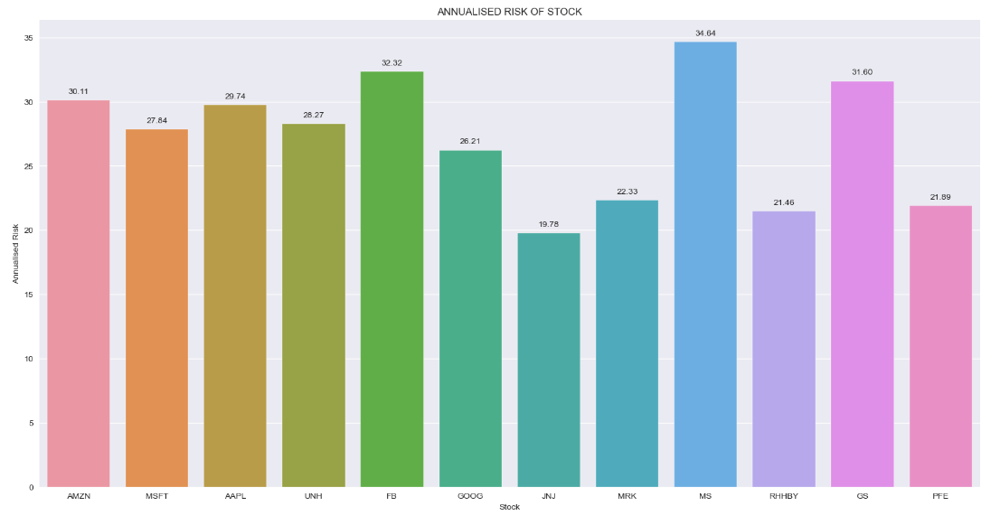
7 - Annualised Risk From each stock continued..

Slide 35
8 - Annualised Cumulative Return From each stock
The cumulative return is the total change in the investment price over a set time—an aggregate return, not an annualized one.
Reinvesting the dividends or capital gains of an investment impacts its cumulative return.
Cumulative return figures for ETFs and mutual funds typically omit the impact of annual expense ratios and other fees on the fund's performance.
Taxes can also substantially reduce the cumulative returns for most investments unless they are held in tax-advantaged accounts.

Slide 36
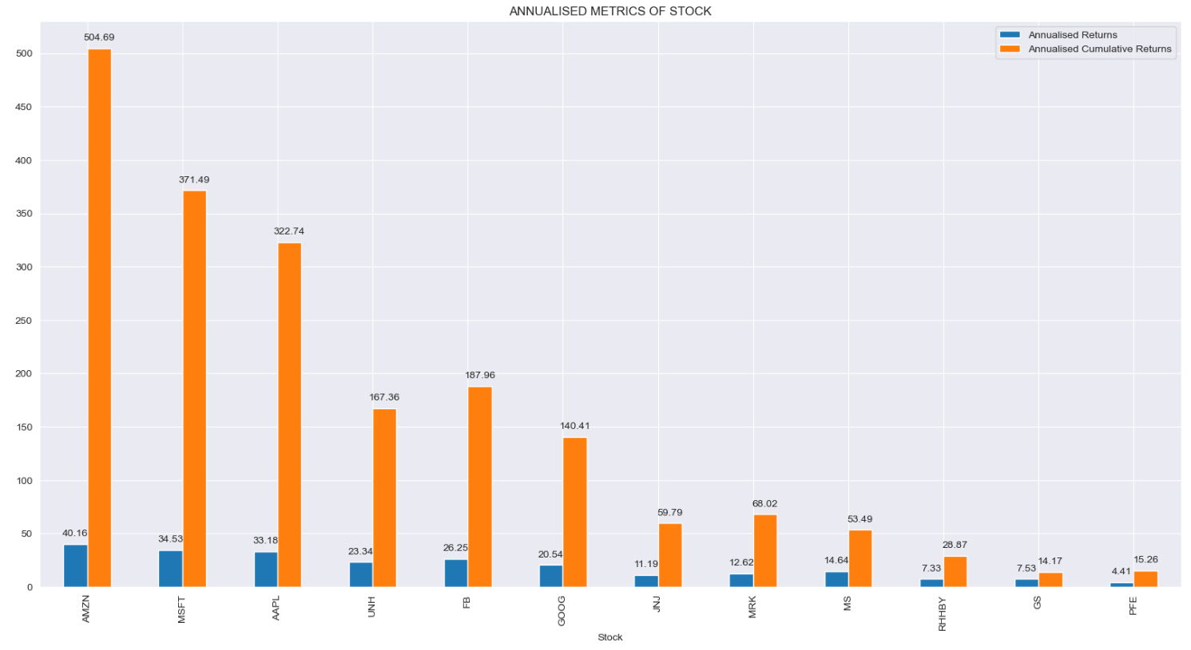
Annualised returns bar plot

Slide 37
Annualised returns bar plot continued..
Please note that the annualised metrics bar plot is plotted after discarding all stocks with negative returns and very low Sharpe ratio
Below are some observations that can be made from the annualised metrics bar plot:
AMZN has the highest annualised daily returns as well as highest annualised cumulative returns
PFE has the lowest annualised returns among all the stocks
MSFT and AAPL also show a high annualised returns as well as high cumulative returns as well

Slide 38
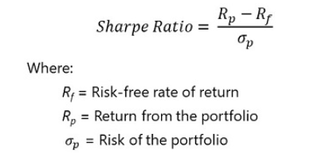
9 - Sharpe Ratio
Sharpe ratio helps the investor to realize the excess returns earned to endure the extra volatility of a riskier asset.
The ratio tries to achieve this by removing the returns earned by investing in a risk-free asset from the overall returns of the portfolio. The risk-free rate of return (Rf) is the return on an investment with zero risk, meaning it's the return investors could expect for taking no risk.
Generally, the assets backed by the government are considered risk-free because the investor is assured of the returns (for example, U.S. Treasury bonds). A high sharpe ratio suggests that the reward per unit of risk is high for the investment. Therefore, it is expected that a good portfolio will have a high Sharpe ratio after diversification.

Slide 39
9 - Sharpe Ratio continued
The below table shows the indicators of the good and bad Sharpe Ratio. Investments having less than 1.00 do not generate higher investor returns
However, investments with Sharpe Ratio between 1.00 to 3.00 are considered great Sharpe Ratio and investments above 3.000 are considered excellent Sharpe Ratio
Sharpe Ratio | Risk Rate | Verdict
Less than 1.00 | Very low | Poor
1.00 – 1.99 | high | Good
2.00 – 2.99 | high | Great
3.00 or above | high | Excellent

Slide 40
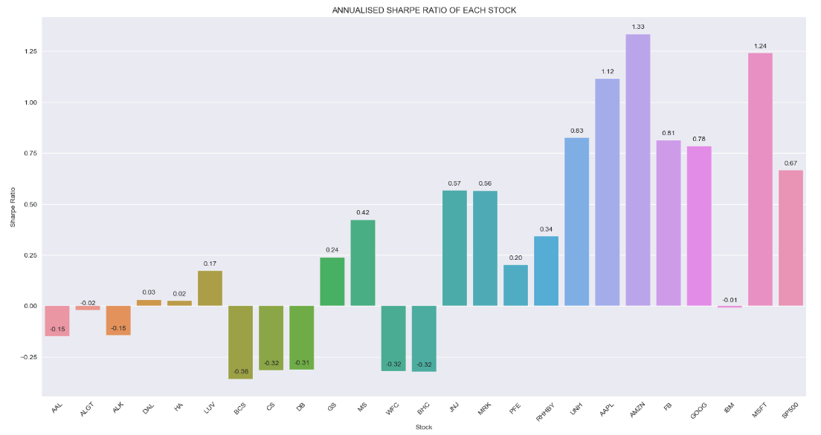
9 - Sharpe Ratio continued..

Slide 41
9 - Sharpe Ratio continued
Below are the observations that can be made from the Sharpe ratio bar plot:
AMZN has the highest Sharpe ratio of 1.33 while BCS has the lowest Sharpe ratio of -0.36
AMZN with the highest Sharpe ratio is expected to generate higher investor returns
All stocks in the bar plot having Sharpe ratio of less than 1 are considered to generate lesser investor returns
If two funds offer similar returns, the one with higher standard deviation will have a lower Sharpe ratio. In order to compensate for the higher standard deviation, the fund needs to generate a higher return to maintain a higher Sharpe ratio.
In simple terms, it shows how much additional return an investor earns by taking additional risk. Intuitively, it can be inferred that the Sharpe ratio of a risk-free asset is zero.

Slide 42
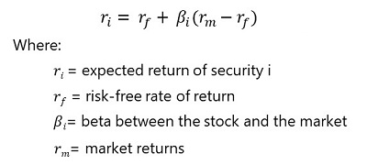
10 - Capital Asset Pricing Model (CAPM)
The capital asset pricing model (CAPM) describes the relationship between the systematic risk and the expected return for assets and is mainly used for stocks
CAPM tries to capture this investment risk and the amount of return that an investor should expect on the investment

Slide 43
10 - Capital Asset Pricing Model (CAPM) continued..
The model clearly highlights the relationship between risk and returns. If an investor is willing to take higher risk, they should be awarded with higher returns too. Let us look at the components of CAPM in detail.
Expected return (ri) represents the expected return of a capital asset over time, given all the variables in the equation. It is a long anticipation about how an investment will play out over its entire life.
Risk-free rate(rf) is the rate of return over an investment with zero risk. You have covered this in the previous segment. A risk-averse investor will prefer the securities that offer returns equivalent to risk-free rate rather than higher returns with unknown risks.
Market rate (rm) is the expected return on the market portfolio. The market portfolio is a bundle of investment that contains all the assets in the investment universe. The expected return on the market portfolio is the same as the expected return of the market as a whole. Indices like S&P 500, Dow Jones Industrial Average (DJIA), etc., are used to estimate the market rate.

Slide 44

10 - Capital Asset Pricing Model (CAPM) continued..
This equation suggests that the regression equation can be helpful in understanding the relationship between the excess return (eliminating the risk-free rate) provided by the security and the excess return provided by the market.
'∝' will be the excess return of the security as compared to market index returns.
'β' is the same as the measure of volatility used in CAPM.
Beta (ꞵ) is the measure of volatility in the stocks that represents the fluctuations in its price compared to the overall market. In simple words, it is the sensitivity of the stock towards the market risk.

Slide 45
10 - Capital Asset Pricing Model (CAPM) continued..
The value of beta gives a good sense of how the stock is behaving with respect to the market. The following points summarise the interpretation of the measure:
= 1.0 : Stock price activity is strongly correlated with the market. Hence, it will shift according to the market.
< 1.0 (defensive) : The security is theoretically less volatile than the market. The changes in the market will not affect the price of the stock by much. For example, utilities and consumer goods stocks.
>1.0 (aggressive): Security’s price is more volatile than the market. If a company’s beta is 1.5, the security has a volatility of 150% in comparison to the market. It shows that the company will do better if the economy is booming and worse in case of recession.

Slide 46
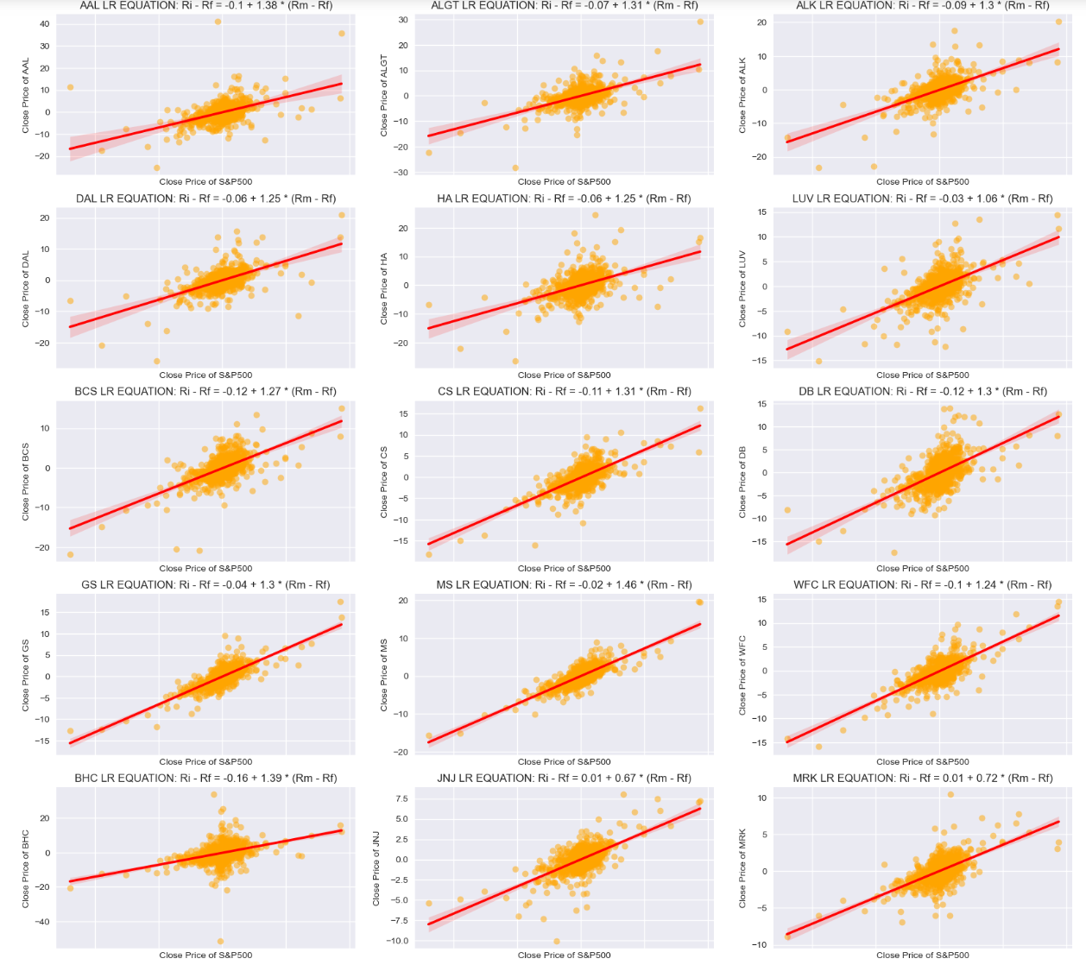
10 - Capital Asset Pricing Model (CAPM) continued..

Slide 47
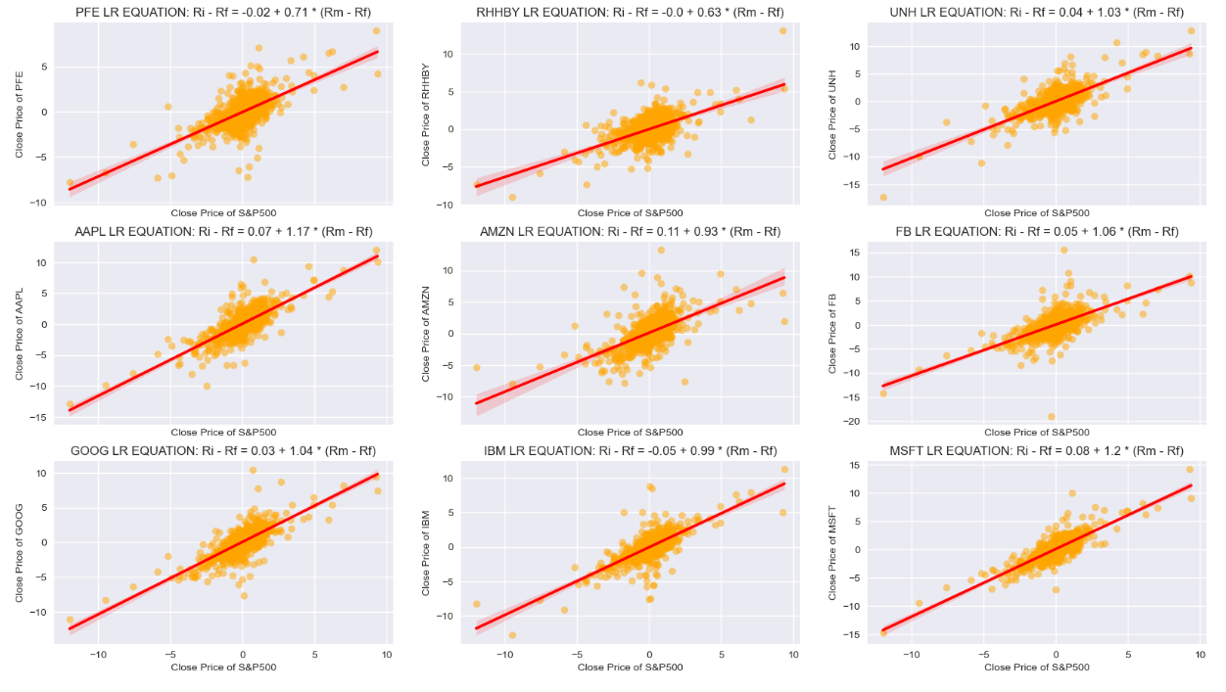
10 - Capital Asset Pricing Model (CAPM) continued..

Slide 48
10 - Capital Asset Pricing Model (CAPM) continued..
We fitted a linear regression model on each of our stock datasets
The two plots in the previous slides show the fitted linear regression line for each of the stock data
Below observations can be made from the LR model:
The beta value is greater than 1 for stocks like MS, BHC, AAL, etc. making them aggressive stocks that are more volatile than the market. It shows that these stocks will do better if the economy is booming and worse in case of recession
The beta value is lesser than 1 for stocks like AMZN, MRK, IBM, etc. making them defensive stocks that are less volatile than the market. The changes in the market will not affect the price of the stock by much

Slide 49
Task 6 – portfolio management

Slide 50
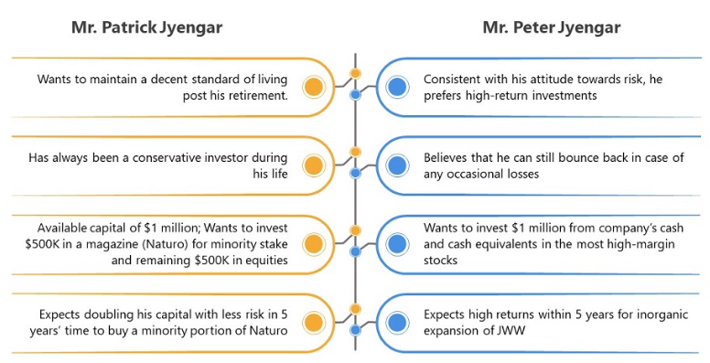
Assess our customers

Slide 51
Assess our customers
As we can see from the picture in the previous slide, Mr. Patrick Jyenger wants to maintain a descent standard of living, hence will mostly likely to go with less riskier stocks in the market
This is in direct contrast with our second customer, Mr. Peter Jyenger who prefers riskier stocks with the promise of getting high returns
A portfolio needs to be made for these two customers keeping in mind their exact requirements which should go in line with the stock analysis we conducted so far

Slide 52
Mr. Patrick Jyenger Stock Portfolio (Conservative)
For an conservative portfolio, we will go for low risk stocks that show good returns. JNJ is perfect to start with for Mr. Patrick Jyengar's portfolio as it is one of the least risky stocks but also shows that it can provide good returns as well.
We will also provide him with a good blend of stock portfolio from all domains. We will keep higher percentage for stocks that are less risky and have good returns in the long run.
Majority share of our portfolio for Mr. Patrick Jyengar will be of low risk high return stocks.

Slide 53
Mr. Patrick Jyenger Stock Portfolio (Conservative)
Stock | Portfolio
JNJ | 30%
MRK | 15%
PFE | 10%
RHHBY | 5%
AMZN | 5%
FB | 5%
MSFT | 5%
AAPL | 5%
UNH | 5%
GS | 5%
MS | 5%
GOOG | 5%

Slide 54
Mr. Peter Jyengar Stock Portfolio (Aggressive)
For an aggressive portfolio, we will go for high risk stocks that show good returns. AMZN is perfect to start with for Mr. Peter Jyengar's portfolio as it is one of the riskiest stocks but also shows that it can provide good returns as well.
We will also provide him with a good blend of stock portfolio from all domains. We will keep lower percentage for stocks that are less risky and have lower returns.
Majority share of our portfolio for Mr. Peter Jyengar will be of high risk high return stocks.

Slide 55
Mr. Peter Jyengar Stock Portfolio (Aggressive)
Stock | Portfolio
AMZN | 20%
MSFT | 20%
AAPL | 10%
UNH | 10%
GOOG | 10%
FB | 5%
JNJ | 5%
MRK | 5%
RHHBY | 5%
GS | 5%
MS | 3%
PFE | 2%

Slide 56
Task 7 – portfolio Analysis

Slide 57
Stock profit formula and implementation
The formula to calculate stock profit from annualized returns is:
Profit = Initial Investment x ((1 + Annualized Returns)^(Holding Period/Number of Years)) - Initial Investment
Where:
Initial Investment: The amount of money invested at the beginning
Annualized Returns: The average rate of return per year over a period of time
Holding Period: The length of the investment period in years
Number of years: Here it is 1 since the metric is annualised for 1 year

Slide 58
Mr. patrick Jyengar Stock Portfolio analysis
Mr. Patrick wants to invest 500K in a magazine 'Naturo' and the rest will be invested in equities. So the initial investment we have for the stock is 1M - 500K = 500K
We will calculate returns and profit for the next 5 years. So holding period will be 5 years
We also assume that the annualised returns of the stocks remains same for all 5 years
He expects doubling his investment in the next 5 years to buy a minority portion of the magazine 'Naturo'

Slide 59
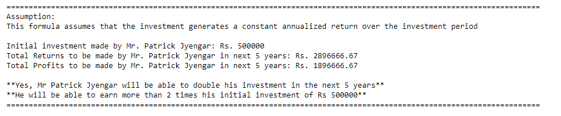
Mr. patrick Jyengar Stock Portfolio results

Slide 60
Mr. Peter Jyengar Stock Portfolio analysis
Mr. Peter wants to invest 1 million of the company's cash in high margin stocks
We will calculate returns and profit for the next 5 years. So holding period will be 5 years
We also assume that the annualised returns of the stocks remains same for all 5 years
He also expects to earn high returns within 5 years of investment

Slide 61
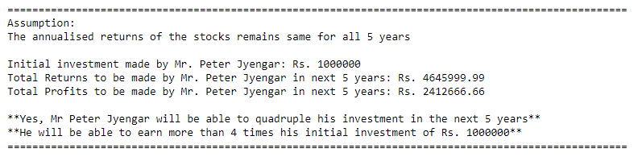
Mr. Peter Jyengar Stock Portfolio results

Slide 62


Thank you!!!

